Slide 1

Final Presentation
SB01 CMUSV One Cheng-Chuan Peng, Avery Winters-McCabe, Chi-Pin Yeh, Shang-Yi Yu, Karen Hao-Yi Tu
Notes:
Chen-Chuan
Hello everyone
we are team SB01 and our project is the CMUSV one. Our group members are:

Slide 2
Agenda
01
04
02
05
03
06
Intro
Design Pattern
Technical Design Decisions
Lesson Learned
Demo
Summary
Notes:
Chen-Chuan
Here is the agenda of our today’s presentation

Slide 3
Identified Problems
Scattered Information
Slack channels, emails and resources calendars
Notes:
Chen-Chuan
CMU SV One is trying to solve the problem of
scheduling meetings and events among students, staff, and faculty
The first problem is
There is no unified and easy access to the meetings and events-related resources, and we need to find info from slack..

Slide 4
Identified Problems
Scattered Information
Inefficient Scheduling Process
Slack channels, emails and resources calendars
Message back and forth to decide a group event
Notes:
Chen-Chuan
2nd problems is
students need to send a message back and forth to decide on an event, so the scheduling event of the process is inefficient,

Slide 5
Identified Problems
Scattered Information
Inefficient Scheduling Process
Lack of visibility
Slack channels, emails and resources calendars
Message back and forth to decide a group event
There is no view about availability of people and location resources
Notes:
Chen-Chuan
3rd problem is
There is no view of every people and location resources’ availability, so currently it is convenient for cmu faculty to check the people and meeting room availability
I’ll pass to chipin

Slide 6
Solutions Overview
Meeting Room Reservation
Scattered Information Inefficient process Lack of visibility
Notes:
To solve the problem, we provide a one-stop meeting room application. It consists of five main functions.
Meeting Room Reservation: It’s a dedicated service help you to book and manage the meetings.

Slide 7
Solutions Overview
Meeting Room Reservation
Search Meeting Room
Scattered Information Inefficient process Lack of visibility
Notes:
Search Meeting Room: This function allows you to filter out the meeting rooms based on your options

Slide 8
Solutions Overview
Meeting Room Reservation
Search Meeting Room
Meeting Notification
Scattered Information Inefficient process Lack of visibility
Notes:
Meetings Notification: to let you send a email to notify all meeting participants

Slide 9
Solutions Overview
Meeting Room Reservation
Search Meeting Room
Calendar View
Meeting Notification
Scattered Information Inefficient process Lack of visibility
Notes:
Calendar View: so that you can view your schedule and check when you are busy or available

Slide 10
Solutions Overview
Meeting Room Reservation
Search Meeting Room
Calendar View
Meeting Notification
Calendar Sharing
Scattered Information Inefficient process Lack of visibility
Notes:
Calendar Sharing: It makes you be able to share your calendar with somebody else(csv)

Slide 11

Technical Aspect: Design Decisions
Notes:
Shang-Yi
After the quick overview on the problems and the solution of our application, let's dive down into the technical overview(1:30)

Slide 12

Design Decisions
User Friendly Agility Small Team Mix of Technology
Notes:
Owner: Shang-Yi
Now I’m gonna talk about the our design decisions. For items that we’ve discussed before, I’ll skip the details of them and focus on what changes only.

Slide 13
Design Decisions
01
RWD (Responsive Web Design ) Web app
User Friendly Agility Small Team Mix of Technology
Notes:
Owner: Shang-Yi
First, like what we mentioned, our application is a responsive web design application. We make the application accessible across all kinds of the devices.

Slide 14
Design Decisions
01
02
RWD (Responsive Web Design ) Web app
RESTful API & JSON format
User Friendly Agility Small Team Mix of Technology
Notes:
Owner: Shang-Yi Second we adopt RESTful API with JSON format.

Slide 15
Design Decisions
01
02
03
RWD (Responsive Web Design ) Web app
RESTful API & JSON format
JWT Token for authentication method
User Friendly Agility Small Team Mix of Technology
Notes:
Owner: Shang-Yi
We also take advantage of JWT token as authentication method because most members in our group use that before.

Slide 16
Design Decisions
01
02
03
04
RWD (Responsive Web Design ) Web app
RESTful API & JSON format
JWT Token for authentication method
Backend: Express & Flask & Frontend: Reactjs
User Friendly Agility Small Team Mix of Technology
Notes:
Owner: Shang-Yi
With the course limitation in terms of using microservice we use python with Flask and javascript with Express as our the backend framework. And, we use TypeScript and React in the front end.

Slide 17

Design Decisions
01
02
03
04
05
RWD (Responsive Web Design ) Web app
RESTful API & JSON format
JWT Token for authentication method
Backend: Express & Flask & Frontend: Reactjs
Microservice architecture & API gateway
User Friendly Agility Small Team Mix of Technology
Notes:
Owner: Shang-Yi
We decide as a team to use microservice architecture because we want to practice this kind of architecture.

Slide 18

Design Decisions
01
02
03
04
05
06
RWD (Responsive Web Design ) Web app
RESTful API & JSON format
JWT Token for authentication method
Backend: Express & Flask & Frontend: Reactjs
Microservice architecture & API gateway
3rd Party API
SendGrid
User Friendly Agility Small Team Mix of Technology
Notes:
Owner: Shang-Yi
At the end, we adopt 3rd party service called SendGrid to send email notification to our clients. Next, I’m gonna hand over to Chi-Pin.

Slide 19
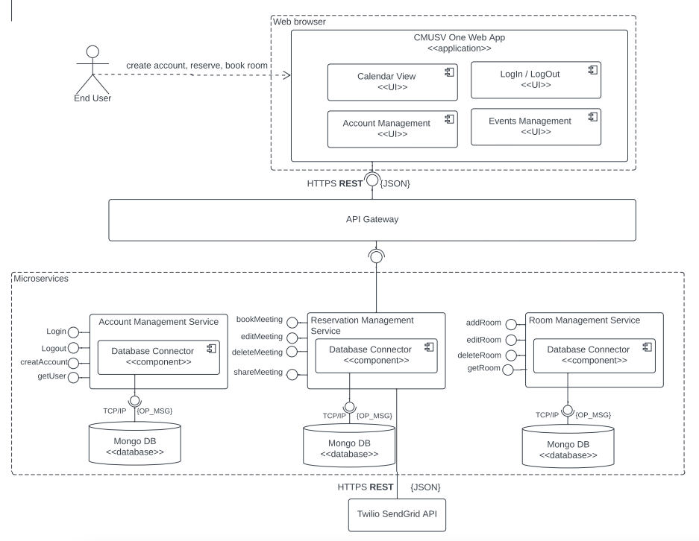



Architecture
(Microservices)
Notes:
This is our architectural component diagram of our application
Out of the reason for agile delivery, small focus team and mix-technology, we chose microservice as you can see we break down the functionality into 3 major microservices, with react in frontend, node and flask in backend.
First, the architecture makes the code base small, separated and enable us to adopt polyglot programming. Bug fixes and feature releases are more manageable and less risky, too.
Moreover, since we can deployed each of the services independently, this enables us to work in an agile development and achieve high availability to eliminate the downtime
With the API gateway, it helps us to decouple the client from the backend services because it acts as a single entry point for all clients as well as an edge service for exposing microservices to the outside world.
============================================
https://lucid.app/lucidchart/aadd89f7-e8e6-464d-aff8-f1716d7f665d/edit?beaconFlowId=44A3D3F055A0B5D3&invitationId=inv_8da41ae4-0d1d-44f5-b8b6-c6bd35e49988&referringApp=slack&page=0_0#
Communication between the microservices (microservices orchestration vs choreography?)
This is our architectural component diagram of our application
We are going to use Microservice with the choreography architecture
Out of the reason for agile delivery, small focus team and mix-technology, we chose microservice as you can see we break down the functionality into 3 major microservices:
First, the arch makes the code base small, separated and enable us to adopt polyglot programming
Moreover, since we can deployed each of the services independently, this enables us to work in an agile ethnic and achieve high availability to eliminate the downtime
With the API gateway helps us to decouple the client from the backend services
And our microservice will going to interact with each other with the Choreography style Since our services is small and simple
(Asynchronous comm, across internal microservices polling http)And want to make the micro services capable of self managing and coupled in loosed manner and
https://moduscreate.com/blog/understanding-microservices-with-an-event-driven-approach/ —
We are going to
agile delivery, easy response to requirements / high availability(eliminate the downtime), manageability, deploy (compare to monolithic)
Microservice
Small, independent, loosely coupled separate codebase, polyglot programming => suitable for small team can write and maintain, diff framework
Deployed independently => agile delivery, high availability(eliminate downtown), manageability
API gateway
Decouple from clients from services(versioned and refactored w/o update all clients)

Slide 20

Demo
Notes:
Karen

Slide 21
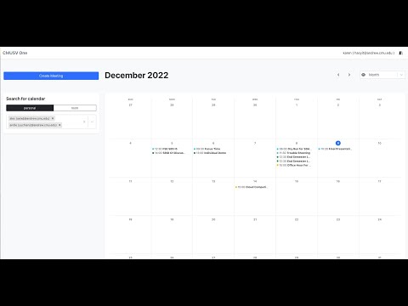
Demo
Notes:
Karen
After the user authenticate the email and password, they will land on the Calendar view page
Meeting Room Reservation: validate the required input fields
Search Meeting Room: after getting the start time and end time. We will hit a search available room api
Notification (Email all attendees): user can also opt to send an email notification
Calendar Sharing(export csv) and opt to export the calendar info into CSV that which can be further use in other calendar app
After filling the information, we can see the event csv is download,
Export the csv sharing is downloaded and can share to others’
and let’s go the the gmail and check we got the notification email
Import in the google calendar
Finally, back to the calendar View
Week-Based
Month-Based

Slide 22

Technical Aspect: Design Pattern
Notes:
Shang-Yi
Alright, thanks for Karen’s demo. Now I’m gonna to talk about our design patterns.

Slide 23
Design Patterns
Expect only one global entry for email client - Singleton Pattern (creational pattern)
Different behavior between success and error message - Factory Method (creational pattern)
User’s upcoming meetings can be viewed in different unit options (a week and a month) - Strategy Pattern (behavioral pattern)
Notes:
Shang-Yi
Here we’ll focus on patterns that we’ve updated - the singleton pattern - and new patterns we added for our content - Factory Method and Strategy pattern.

Slide 24
Design Patterns
Expect only one global entry for email client - Singleton Pattern (creational pattern)
Different behavior between success and error message - Factory Method (creational pattern)
User’s upcoming meetings can be viewed in different unit options (a week and a month) - Strategy Pattern (behavioral pattern)
Service Level Access Control/Sequential Checks for APIs - Chain of Responsibility (behavioral pattern)
Client must interact with several Services - Facade (structural pattern)
Notes:
Shang-Yi
Here are two patterns that we’ve talked before - chain of responsibility and facade pattern - that we proposed last time. It doesn’t change that much so we won’t dive into detail.

Slide 25
We expect a single entry for external dependency
Problem:
We want to have a single point of entry for our external dependency SendGrid client.
Notes:
Shang-Yi
Our first pattern is Singleton pattern. To help CMU-SV One customers - our faculty and students, we take advantage of a third-party service called SendGrid to help us send email notifications to our customers.
We want to have a single point entry for our external dependency here,

Slide 26
We expect a single entry for external dependency
Problem:
We want to have a single point of entry for our external dependency SendGrid client.
Solution - Singleton:
Notes:
Shang-Yi
so we choose Singleton as our solution here.

Slide 27
We expect a single entry for external dependency
Problem:
We want to have a single point of entry for our external dependency SendGrid client.
Solution - Singleton:
Provides global access point for email client instance
Notes:
Shang-Yi
As you can see here, Singleton provides us a global access point for our SendGrid client instance,

Slide 28
We expect a single entry for external dependency
Problem:
We want to have a single point of entry for our external dependency SendGrid client.
Solution - Singleton:
Provides global access point for email client instance
Ensures only one email client instance exists
Notes:
Shang-Yi
and it also ensures that only one SendGrid client instance exists in our application.

Slide 29
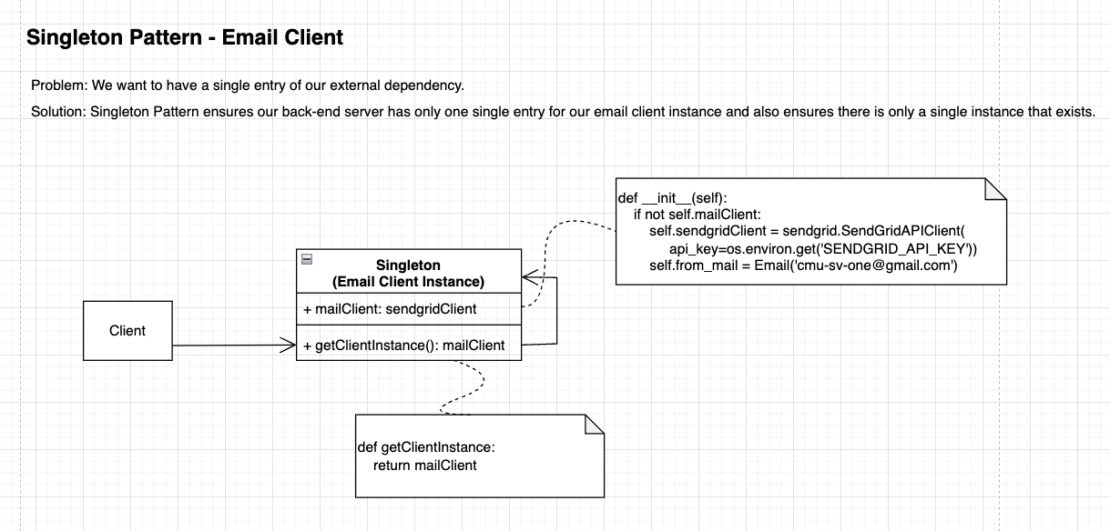
Notes:
Here is the updated UML diagram. Since everyone is quite familiar with this one, I’m not gonna dive into the detail of this page. Next I’m gonna pass to Chi-Pin.

Slide 30
Problem: Success message & Error message have different behavior
Problem:
Whenever failure happens, we want to log the message
Duplicate codes everywhere while generating the HTTP Response
Notes:
This problem is that we want success message and error message have different behaviors.
Specifically, in order to make our service become more reliable and have better performance, we want to lower the percentage of probability of failure, so whenever failure happens, we want to log the message such that we can check afterwards and reproduce the error since we have kept the snapshot of the http header & payload.
In addition to this, we identify another problem that the duplicate codes everywhere while generating the Http response.
It is because the same status code will generate the same returned message, which causes the message creation code to be scattered across the application at different http endpoints.

Slide 31
Problem: Success message & Error message have different behavior
Problem:
Whenever failure happens, we want to log the message
Duplicate codes everywhere while generating the HTTP Response
Solution:
Apply Factory Method to have different implementation of success and error message during response
Notes:
So, we apply factory method pattern to have different implementation of success and error message.

Slide 32
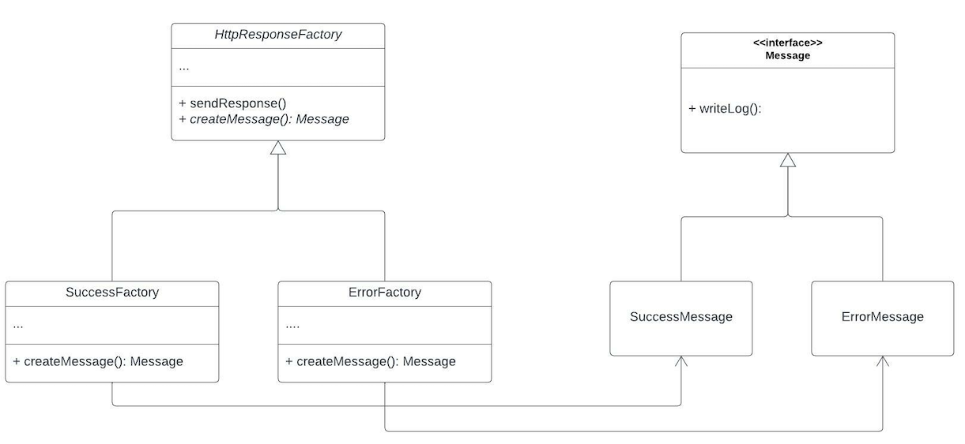
Factory Method Pattern
Notes:
This picture shows that our base class is HttpResponseFactory, which declares abstract factory method, “createMessage”.
And each sub factory implements its own factory method to return a new message object from corresponding message subclass. In our scenario, we have two different message type, success and error.
In terms of error message, we not only want to write the log to the console, but also want to output error message to an external log file.

Slide 33
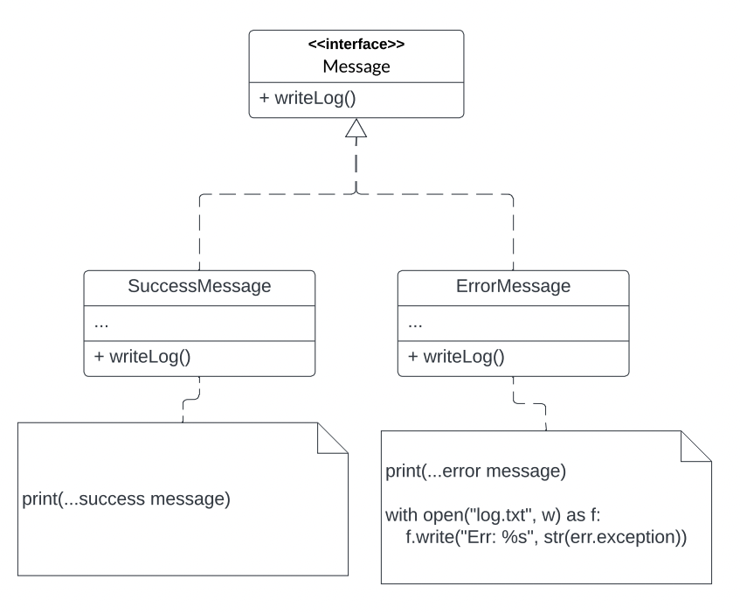
Factory Method Pattern
Notes:
In the process of writing log, both of them will send the log to the console. However, there will be a different implementation in error message handling. It has to additionally dump the error to the log file. According to such characteristics, the factory method can give these two message behave differently.

Slide 34
Problem: User’s upcoming meetings need to be viewed in different unit options
Problem:
There are different view-unit variants to alter the same date object array during runtime
We need to isolate the view changing logic of a class from the implementation details
Notes:
Karen

Slide 35
Problem: User’s upcoming meetings need to be viewed in different unit options
Problem:
There are different view-unit variants to alter the same date object array during runtime
We need to isolate the view changing logic of a class from the implementation details
Solution:
Apply Strategy Pattern on the calendar page to help us to extract the the different view rendering algorithms into separate classes
Notes:
Karen
On the Calendar view page users have two options to choose from the drop down. Since the algo may be

Slide 36
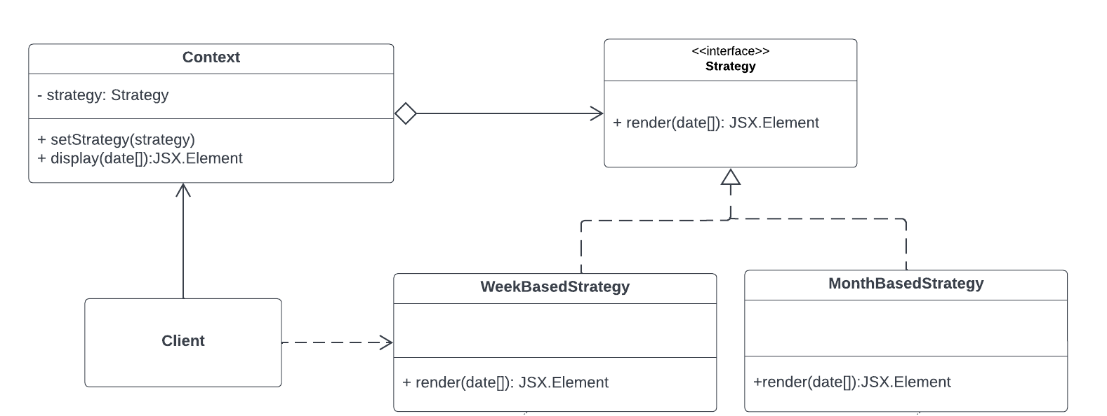
Strategy Pattern
Notes:
Karen
Context https://github.com/cmusv-sasd/sb1-front-end/blob/main/src/design-pattern/strategy/Calendar.tsx
Strategy, Concrete Strategies
https://github.com/cmusv-sasd/sb1-front-end/blob/main/src/design-pattern/strategy/Strategies.tsx
Client https://github.com/cmusv-sasd/sb1-front-end/blob/main/src/components/calendar/CalendarContainer.tsx

Slide 37
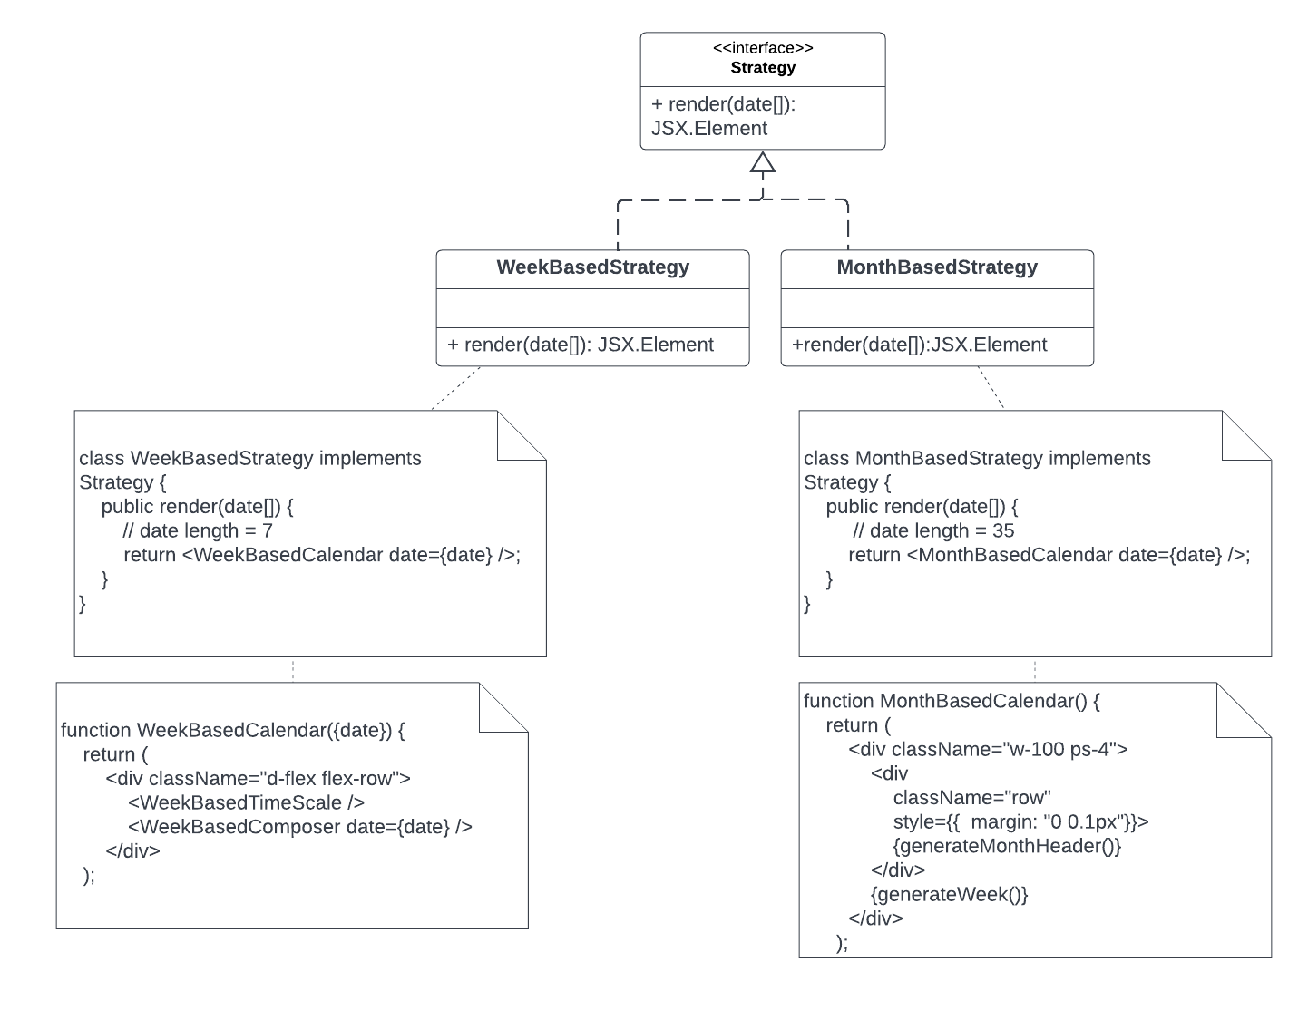
Strategy Pattern
Notes:
Karen
Context https://github.com/cmusv-sasd/sb1-front-end/blob/main/src/design-pattern/strategy/Calendar.tsx
Strategy, Concrete Strategies
https://github.com/cmusv-sasd/sb1-front-end/blob/main/src/design-pattern/strategy/Strategies.tsx
Client https://github.com/cmusv-sasd/sb1-front-end/blob/main/src/components/calendar/CalendarContainer.tsx
Next I am going to hand over cheng-chun to talk about the problem we identified and its corresponding dp solution

Slide 38
Problem: Service level access control/ sequential checks for APIs
Problem:
We want to restrict the system to only authenticated CMU-SV students, faculty to operate
We want to encapsulate common operations that could share among APIs
Notes:
Chen-Chuan
Problem:
We want to restrict the system to only authenticated CMU-SV students, faculty to operate
We want to encapsulate common operations that could share among APIs

Slide 39
Problem: Service level access control/ sequential checks for APIs
Problem:
We want to restrict the system to only authenticated CMU-SV students, faculty to operate
We want to encapsulate common operations that could share among APIs
Solution:
Apply Chain of Responsibility as middleware in our API Gateway
Use Base Handlers to let other handlers extend for authenticating and validating
Notes:
Chen-chuan
Solution:
Apply Chain of Responsibility as middleware in our API Gateway
Use Base Handlers to let other handlers extend for authenticating and validating

Slide 40
Problem: Client must interact with several Services
Problem:
We are using 3 microservices to build our app and want to hide them from the client
We need to make requests to the different services in a way that is not overly complicated
Notes:
Avery

Slide 41
Problem: Client must interact with several Services
Problem:
We are using 3 microservices to build our app and want to hide them from the client
We need to make requests to the different services in a way that is not overly complicated
Solution:
Use Facade to implement an API Gateway
This will serve as a single point of entry to interact with microservices and route requests appropriately
Notes:
Avery

Slide 42




Benefits
Scalability
Maintainability
Availability
Extensibility
Notes:
Avery
I will talk briefly about this because we covered benefits in our preliminary presentation
Scalability - microservices are independent of eachother and use a unique database, which means it is easier to scale because microservices can be scaled per-service as opposed to scaling the entire app.
Availability- microservice architecture helps decouple subsystems. This means that if one microservice fails, the failure is isolated and will keep the app from crashing because the other services should not be effected.
Maintainability- Each service serves a specific function, and smaller codebases are easier to maintain. This means that when a problem occurs it is easier to tell exactly where it is and fix it
Extensibility- microservices are by nature loosely coupled and have minimal dependency on other services. So, when you want to add new features it is easier to do because you are adding to each microservices, as opposed to the entire app

Slide 43

Lesson Learned
Notes:
Avery

Slide 44
Lesson Learned
Challenges
Learning curve of the TypeScript + React
Redux is redundant to use for a small scaled MVP but beneficial for longer development
Learning curve for setting up docker environment
Not enough spare time to improve user experience
Notes:
Avery

Slide 45
Lesson Learned
Challenges
Learning curve of the TypeScript + React
Redux is redundant to use for a small scaled MVP but beneficial for longer development
Learning curve for setting up docker environment
Not enough spare time to improve user experience
Went well:
API documentation
Docker helped the project for building & running microservices
3rd party API for notifying users
Notes:
Avery

Slide 46

Summary
Notes:
Avery

Slide 47
Summary
We offer a single application for you to efficiently organize meetings and events
Microservice Architecture with API Gateway to loosely decouple the services
Singleton pattern to provide a single access point for an external dependency
Chain of Responsibility pattern to have a sequential check for our system
Facade pattern as a simplified interface to direct the user requests to appropriate microservices
Factory method to efficiently build http responses
Strategy pattern to manage switching between different views of the calendar
Notes:
Avery

